Slide 1
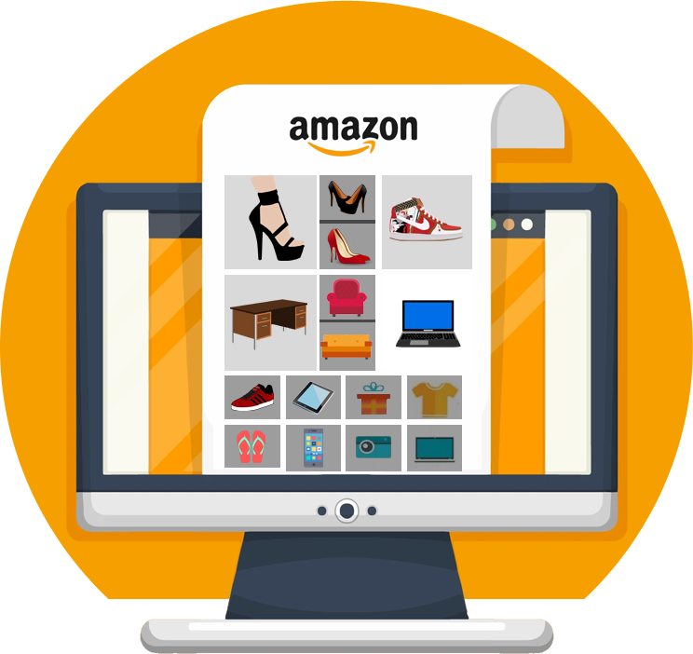
AMAZON ECOMMERCE
DATA ANALYSIS
BY
DEVIKA NITHIAN N H
17 OCT 24

Slide 2
ABOUT
E-commerce Giant: Amazon is one of the world's largest online retailers, offering a vast selection of products across various categories, including electronics, books, clothing, and more.
Global Reach: Amazon operates in numerous countries worldwide, providing customers with convenient access to products and services.
Customer-Centric Approach: Amazon is known for its customer-centric focus, offering features like Prime membership, fast and reliable shipping, and excellent customer service

Slide 3

PROBLEM STATEMENT
As a business analyst how Amazon can leverage its vast customer data to identify high-value customers, tailor offerings to their preferences, and enhance the overall customer shopping experience while maintaining profitability.

Slide 4
DATA SNAPSHOT
Total Customers: 113 unique customers.
Key Columns:
CustomerID: Unique identifier for each customer.
CustomerAge: Age of the customer.
CustomerGender: Gender of the customer (e.g., Male, Female).
Total Orders: Includes thousands of transactions based on CustomerID.
OrderID: Unique identifier for each order.
OrderDate: Date when the order was placed.
DeliveryDate: Date when the order was delivered.
DeliveryType: Mode of delivery (e.g., Standard, Express).
ProductCategory & SubCategory: Categorizes products ordered (e.g., Electronics, Fashion).
Product: Name of the product ordered.
UnitPrice: Price per unit of the product.
OrderQuantity: Number of units purchased in an order.
SalePrice: Total price of the order, including discounts.
ShippingFee: Shipping charges applied to the order.
Status: Whether the product was delivered, returned, etc.
Reason: Explanation for returns (if any).
Rating: Customer feedback in terms of product ratings.

Slide 5

DATA CLEANING AND PREPROCESSING
Handling Missing Values: Identified and filled or removed missing data in critical columns (e.g., filling null values in Order Quantity with averages or dropping rows where key identifiers like CustomerID are missing).
Standardizing Formats: Ensured consistency in date formats, product categories, and numerical data types (e.g., converting date fields to a standard YYYY-MM-DD format and ensuring all numerical fields like prices and ratings were correctly formatted).
Removing Duplicates and Outliers: Removed duplicate entries and outliers (e.g., extreme values in OrderQuantity or SalePrice) to improve the accuracy of analysis and prevent skewed results.

Slide 6
ANALYTICAL APPROACH AND TOOLS
Exploratory Data Analysis (EDA): Conducted EDA to understand patterns, trends, and relationships in the dataset. This included analyzing customer demographics, sales performance, and product popularity.
Segmentation and Filtering: Applied segmentation techniques to categorize customers by demographic factors (age, gender, location) and products by performance metrics (e.g., revenue, ratings).
KPI Calculation: Defined and calculated key performance indicators (KPIs) such as total revenue, order frequency, average rating, and customer satisfaction to identify trends and areas for improvement.

Slide 7
ANALYTICAL APPROACH AND TOOLS
Power BI: Utilized for creating interactive visualizations, dashboards, and reports to present key insights in an intuitive and visually appealing format. Slicers were used for dynamic filtering by product categories, customer attributes, and time periods.
DAX (Data Analysis Expressions): Used within Power BI to create custom measures for calculations like total sales, average ratings, and month-over-month sales comparisons.
SQL: Employed for querying datasets and calculating complex metrics such as total revenue per customer, order frequency, and top-performing products.

Slide 8
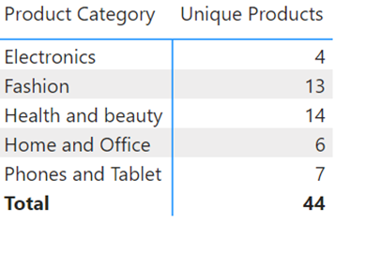
OBJECTIVE QUESTION ANALYSIS
The total revenue of 107.24M indicates that the business has generated substantial sales. This is a positive sign for the company's financial health.
There was a substantial increase in the number of unique customers from 2018 to 2019. This indicates a successful acquisition or retention strategy that attracted new customers and/or retained existing ones during this period.
The company offers a diverse range of products across different categories. This indicates a wide customer base or a strategy to cater to various market segments.

Slide 9
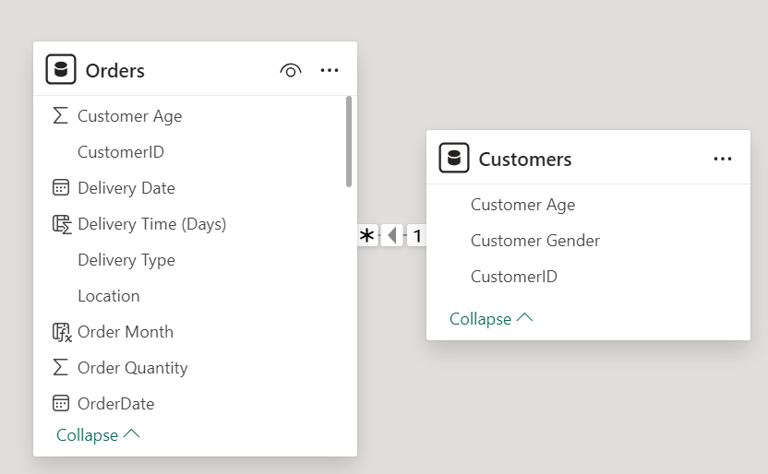
The average delivery time of 9.41 days indicates that the company generally delivers products within a reasonable timeframe.
"Vitamins & Dietary Supplements" and "Medical Supplies and Equipment" are the top-performing subcategories.
10.1'' Business Tablet with MT6582 Quad-Core Processor has shown a significant increase in sales over the years, particularly from 2018 to 2020.
The relationship between the CustomerID in the Orders table and the Customer table, the relationship type will be a one-to-many (1:n) relationship.

Slide 10
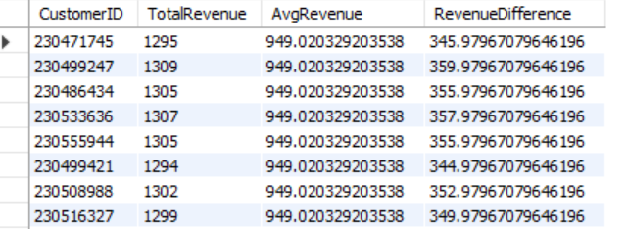
High Customer Value: All customers in the provided dataset have a Composite Score of 5726.3, indicating that they are all considered high-value customers based on the given criteria. This suggests that the company has a strong customer base with a high level of engagement and spending.
The month-over-month growth rate has varied over the period. There have been months with positive growth, indicating increased sales compared to the previous month, as well as months with negative growth, indicating a decline in sales.
Based on the data, there are no customers who have generated revenue more than 30% higher than the average revenue. This could indicate that the company's customer base is relatively homogeneous in terms of spending patterns, or it might be due to a limited dataset.

Slide 11
Genre Performance & Inactive Customers
Genre Sales Performance (USA):
Rock dominates (53.38%), followed by Alternative & Punk (12.37%) and Metal (11.80%).
Mid-tier genres (R&B/Soul, Blues, Alternative) show potential for niche marketing.
Low sales in Jazz, Classical, Reggae, and Electronica/Dance suggest niche audiences.
Customers Inactive in Last 3 Months:
Significant number indicates potential customer churn or disengagement.
Re-engagement campaigns needed (personalized offers, promotions).
Inactive customers might include high-value customers (e.g., Luís Gonçalves).

Slide 12
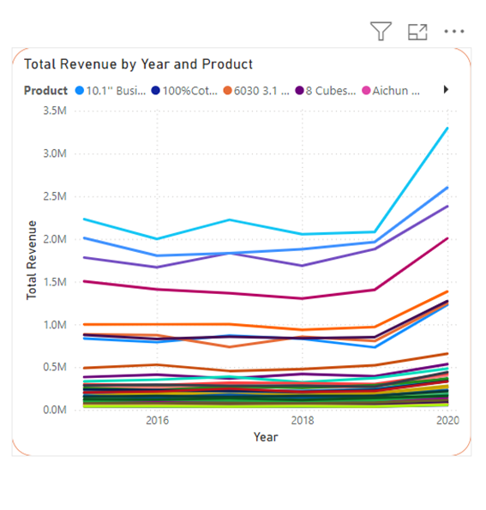
Product Contribution to Annual Revenue
Some products, such as "10.1" Business" and "100%Cotton", have shown significant increases in revenue over the years. This suggests that these products have gained popularity or have been successfully marketed.
Identifying these products can help focus marketing efforts and resource allocation.

Slide 13
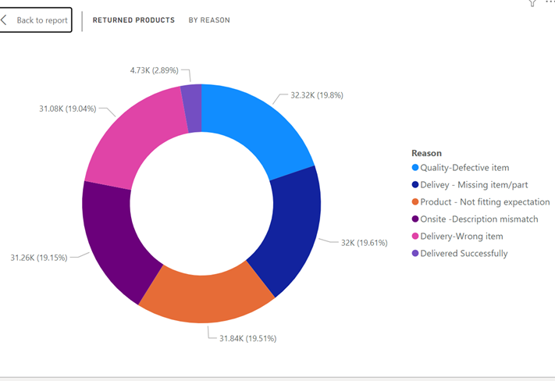
Returned Products
Delivery-Wrong item: This indicates potential issues with order fulfillment or product picking.
Quality-Defective item: This suggests quality control problems or defective products.
Product - Not fitting expectation: This might be due to inaccurate product descriptions or customer expectations not being met..

Slide 14
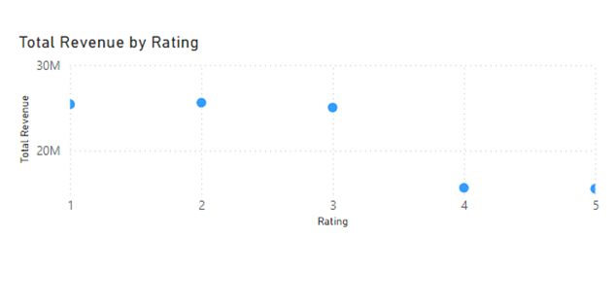
Correlate Ratings and Sales
Electronics might have a higher proportion of 4 and 5 star ratings, while Fashion might have a more balanced distribution.
The products with higher ratings have significantly higher sales, it suggests that ratings play an important role in influencing customer purchasing decisions.
Focus on improving product ratings through better quality, customer service, and encouraging reviews for low-rated products to drive sales.

Slide 15
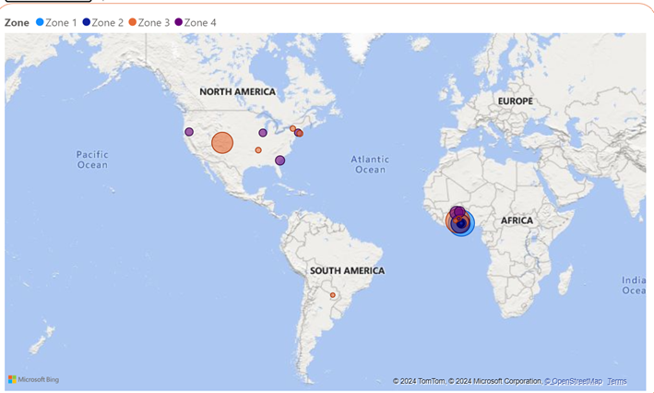
Revenue Distribution Across Location
High-performing regions: Ashanti is one of the high performing region. Allocate more marketing budget to regions that already perform well to consolidate your market position.
Underperforming regions: Boho is the low performing region based on the analysis. Design targeted campaigns to boost awareness or launch promotions in low-revenue regions. Tailor your marketing message to suit regional preferences.
It helps in the company’s market segmentation strategy and make decisions about where to allocate resources most effectively.

Slide 16
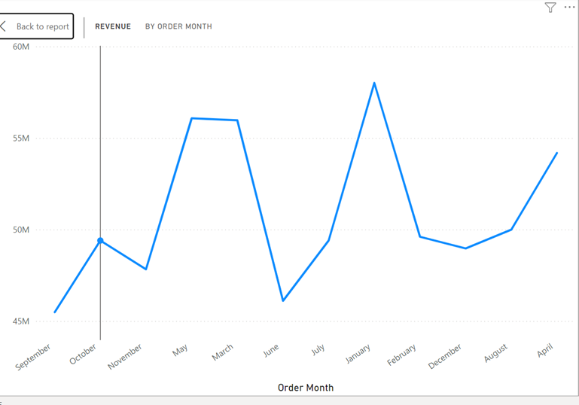
March appears to be a month with relatively lower revenue compared to the surrounding months. This suggests that it might benefit from enhanced promotional offers to boost sales. Regions with lower economic activity or less diversity in musical preferences (e.g., some parts of Europe and North America) exhibit higher churn rates, particularly for genres outside of Rock and Metal.
Create product bundles with complementary items and offer a discount on the bundle to encourage customers to purchase multiple products.

Slide 17
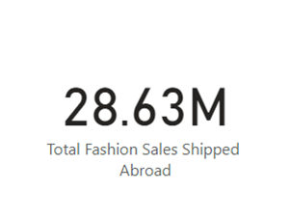
Fashion Sale Shipped Abroad
Market Penetration: The total of 28.63 million in total fashion sales shipped abroad indicates a significant presence in international markets.
Given the substantial international sales, the company should explore opportunities to further expand its presence in foreign markets. This could involve opening new distribution channels, partnering with local retailers, or tailoring product offerings to meet the preferences of international customers.
Optimize logistics and shipping processes to ensure efficient delivery and minimize costs.

Slide 18
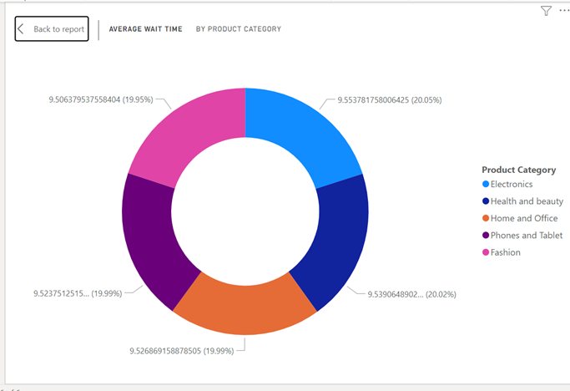
Wait Times Correlated with Demographics and Care
By analyzing Wait time it helps in making data-driven decisions for scheduling and staffing, ultimately improving customer satisfaction and service levels.
While the average wait times are relatively similar across all categories, there are slight variations. "Electronics" and "Phones and Tablet" have slightly higher average wait times compared to the other categories.

Slide 19
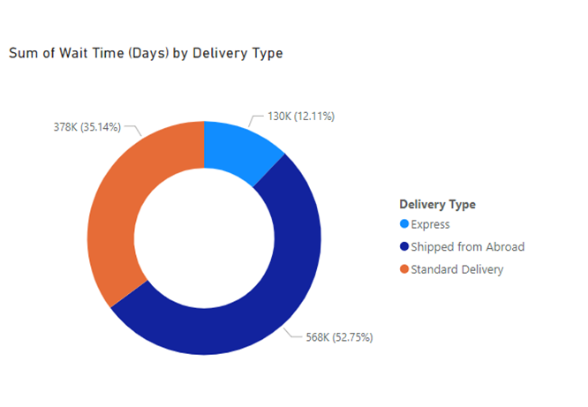
Relationship Analysis
The "Standard Delivery" type accounts for the majority of the total wait time (52.75%), indicating that it generally takes longer for orders to be delivered using this method. "Express Delivery" has a significantly lower share of the total wait time (12.11%), suggesting that it is a faster option compared to Standard Delivery.
Health and Beauty: This category has the highest shipping charges, suggesting that products in this category might be heavier, larger, or require specialized packaging that incurs higher shipping costs.

Slide 20
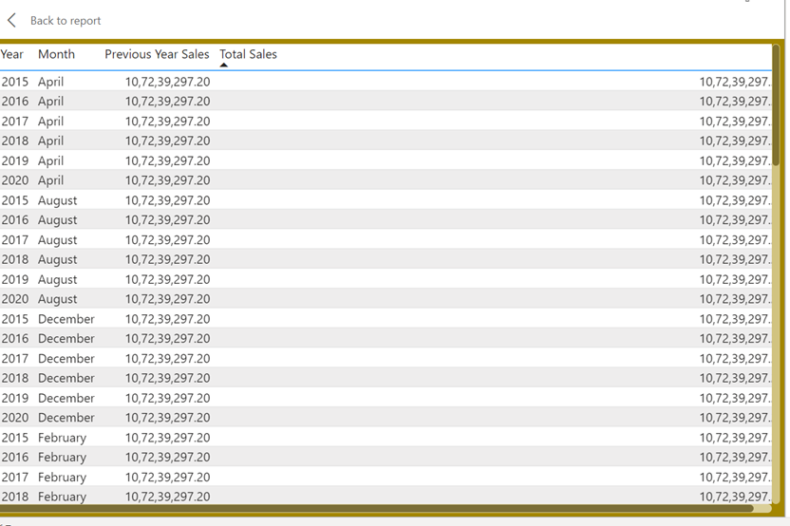
Sales Distribution
Total sales increased from 2015 to 2016. In 2015, the total sales were 75000, and in 2016, it was 82000.
Sales increased compared to the previous year for all months in 2016.
March seems to be the peak season based on this data, as it has the highest total sales among all months.

Slide 21
STRATEGIC RECOMMENDATION
Customer-Centric Approach
Personalized Recommendations: Utilize customer data to provide tailored product recommendations and offers, enhancing the shopping experience and increasing customer engagement.
Loyalty Programs: Implement a robust loyalty program that rewards repeat customers with exclusive benefits, discounts, and personalized experiences.
Customer Feedback: Actively seek and analyze customer feedback to identify areas for improvement and address concerns promptly.

Slide 22
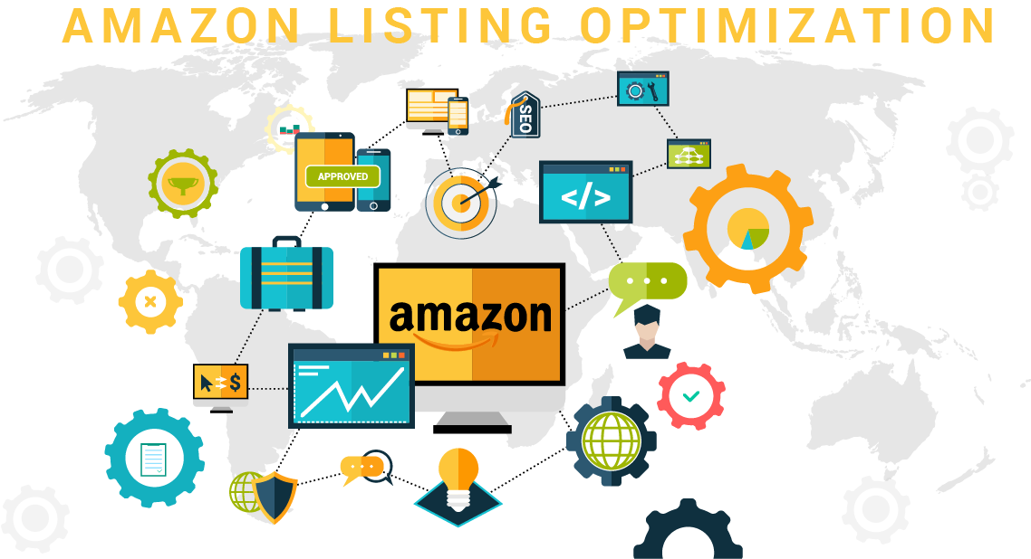
Product Optimization
Product Variety: Continuously expand the product catalog to cater to diverse customer preferences and stay ahead of market trends.
Quality Assurance: Implement rigorous quality control measures to ensure that products meet customer expectations and minimize returns.
Product Bundling: Create attractive product bundles to encourage customers to purchase multiple items and increase average order value.

Slide 23

Marketing and Sales Strategies
Targeted Marketing: Utilize data analytics to identify specific customer segments and tailor marketing campaigns accordingly.
Social Media Engagement: Leverage social media platforms to connect with customers, build brand awareness, and drive traffic to the website.
Influencer Partnerships: Collaborate with influencers in relevant industries to reach a wider audience and promote products effectively.

Slide 24
CONCLUSION
Amazon can leverage its vast customer data to make informed decisions and optimize business strategies.
Implementing personalized marketing campaigns based on customer preferences can increase customer engagement, drive repeat purchases, and improve customer loyalty.
By regularly analyzing customer feedback and market trends, Amazon can identify areas for improvement and make necessary adjustments to its business strategies. This iterative approach will ensure that the company remains competitive and meets the evolving needs of its customers.

Slide 25
THANK YOU !

